Slide 1
Cross-Platform Application Development
Submitted by: Likhit Gatagat
2022MT13057
Bits, Pilani, WILP Email: 2022MT13057@wilp.bits-pilani.ac.in
BITS Pilani
SEZG585/SSZG585 Cross-Platform Application Development
November 17, 2023
1

Slide 2
Flutter App to Manage Task
Synopsis:
We have implemented the CRUD operations for a ToDo App to better understand Parse on Flutter. The application has a simple interface, with a text field to register a task and a list of registered tasks. We can update each task as completed or even delete the task.
We have built a Todo App that stores the tasks in the Back4App Database.
We have performed below high-level tasks to complete the assignment.
Create a Back4App account and create a Backend-as-a-Service to manage tasks.
Create a Flutter app that connects to Back4App.
Implement the necessary functionality to create, read, update and delete the tasks.

Slide 3
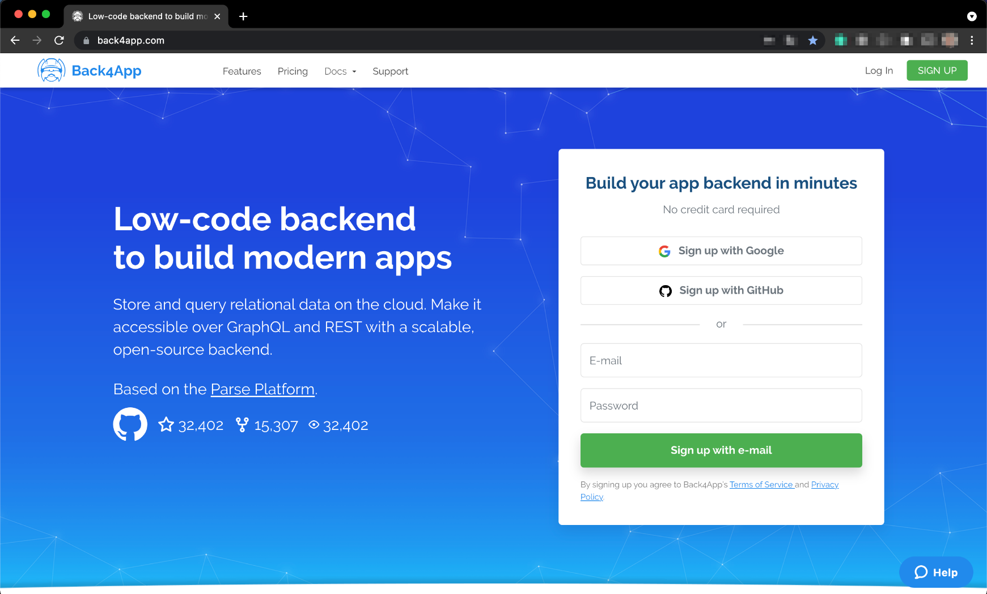
Create and setup Back4App
Step 1 - Create your Back4App account

Slide 4
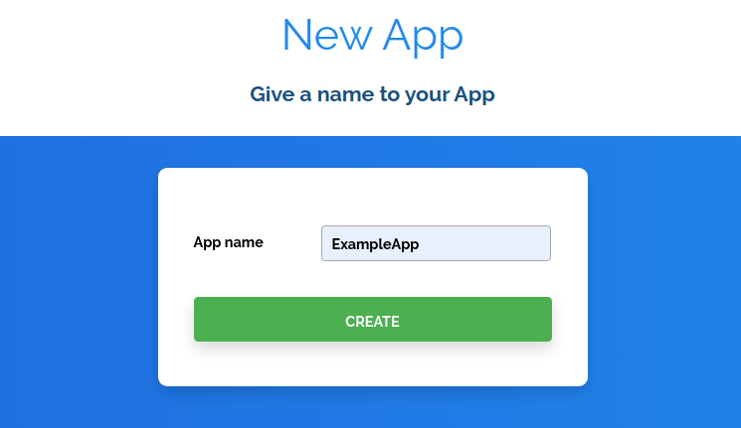
Create and setup Back4App
Step 2 - Create a new app

Slide 5
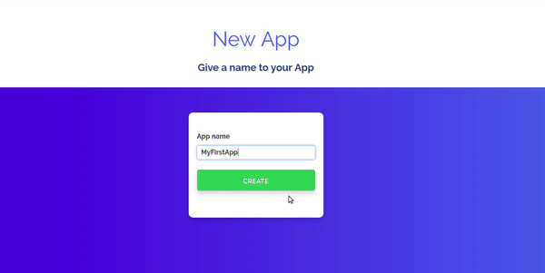
Create and setup Back4App
At this moment, our application backend structure is under construction

Slide 6
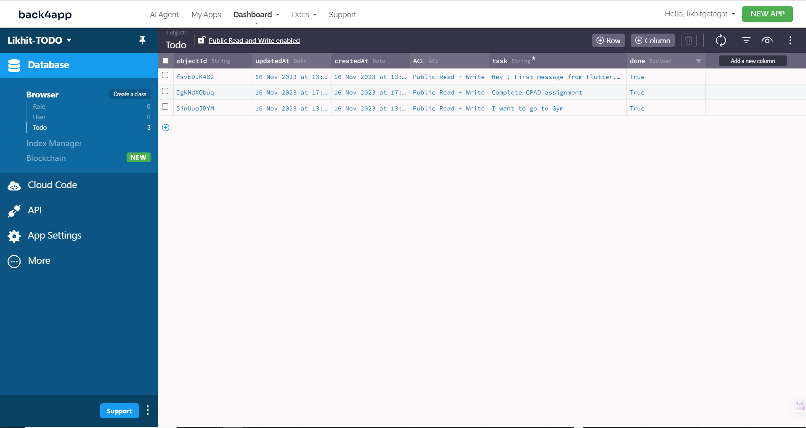
Create and setup Back4App
Step 3 - Navigating on the Back4App Dashboard
After creating the TODO App you will see the Dashboard. Here we can find the Database browser, cloud functions, Push Notifications and the other features available at Back4App. Create a todo class with task (string data type) and done (boolean data type) columns/member variables.

Slide 7
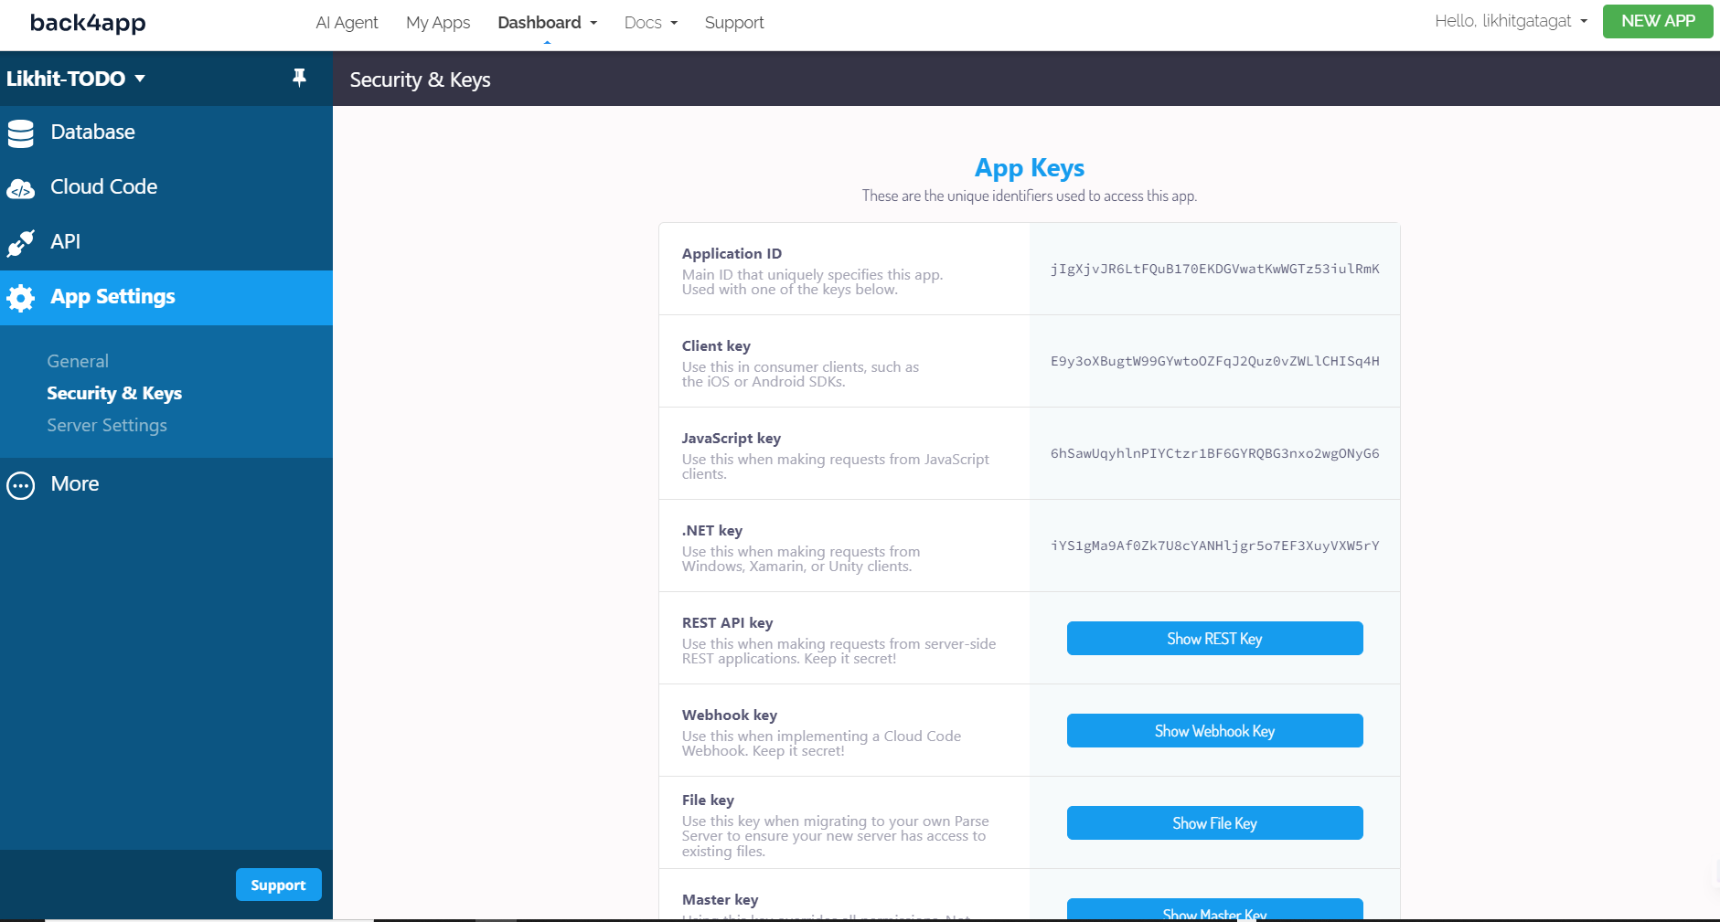
Create and setup Back4App
Step 4 – App Keys
Go to the App Settings to check the App Keys which will be necessary to connect to our TODO App’s frontend to Back4App

Slide 8
Creating TODO flutter project
Prerequisites
Flutter version 2.2.x or later
Android Studio
VS Code installed (with Plugins Dart and Flutter)
A device (or virtual device) running Android or iOS
Step 1 - Creating a TODO Flutter project
flutter create flutter_parse_todo
Step 2 - Installing Flutter plugin for Parse Server
Add the Parse to the project dependencies. Go to pubspec.yaml and add the following
dependencies:
parse_server_sdk_flutter: ^7.0.0
Run the flutter pub get command to install the dependencies in the project.

Slide 9
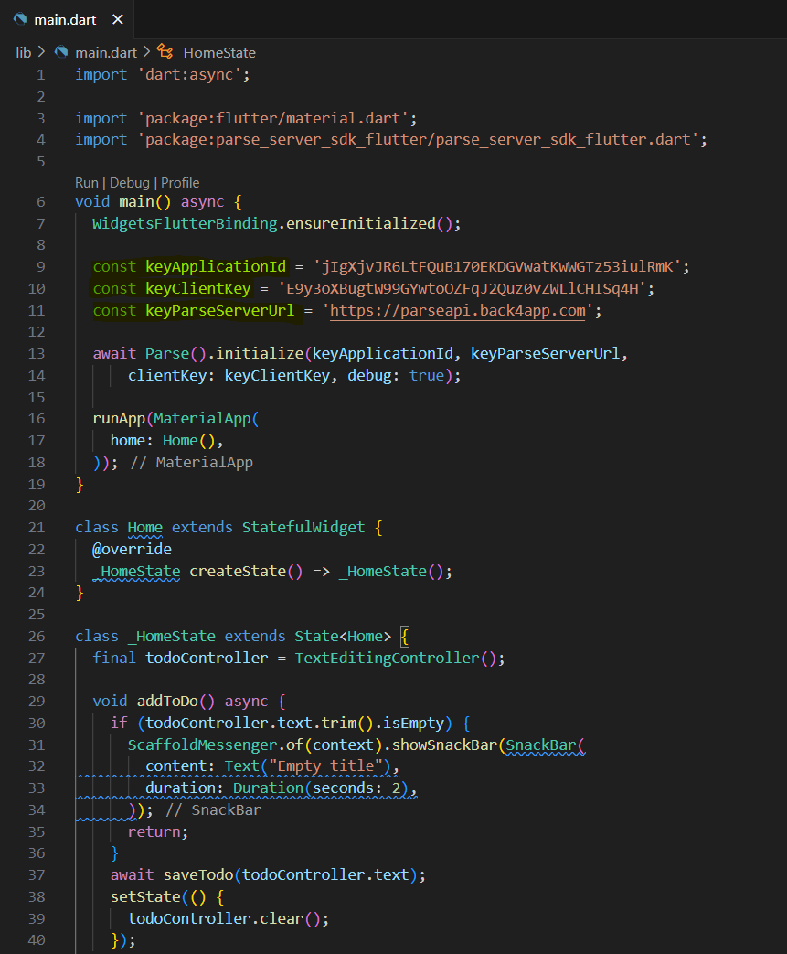
Creating TODO flutter project
Step 3 - Create Todo App
Refer our main.dart file here, this file contains all the code required to create, read, update and delete the tasks from our TODO list.
Step 4 - Connect Todo App to Back4app Project
Find an Application Id and Client Key credentials by navigating to our app Dashboard at Back4App Website.
Update code in main.dart with the values of our project’s ApplicationId and ClientKey in Back4app.

Slide 10
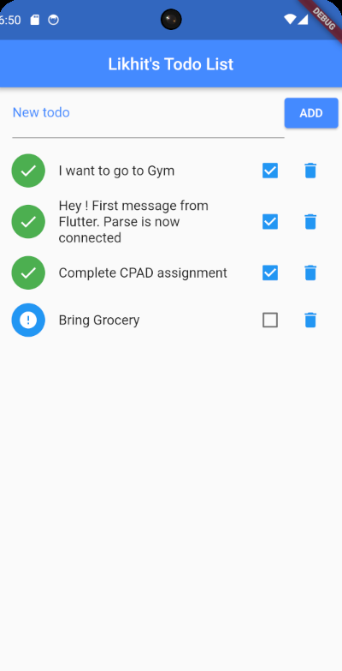
Creating TODO flutter project
Run the project, and the app will load as shown in the image.
Todo front-end app will make a call to Back4App and get the list of tasks.
If a task is marked as done, it will be shown with a green tick mark.
If the task is pending, it will be shown as a todo mark.
User can mark a task as done by clicking the checkbox true.
The user can remove the task from the list by deleting it.
User can add a new task by adding text in the “New Todo” text box and clicking the “Add” button.

Slide 11
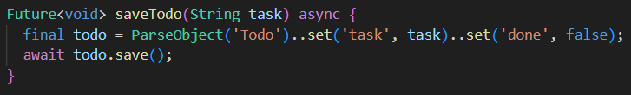
Important Code Snippet
Code for Create Object
The create function will create a new Task with the title and done status equal to false.
Make a new instance of the Parse Todo class with the command ParseObject('Todo’).
Use the set function to set the parameters for this object.
Call the save function, which will effectively register the task to your database in the Parse Dashboard.

Slide 12
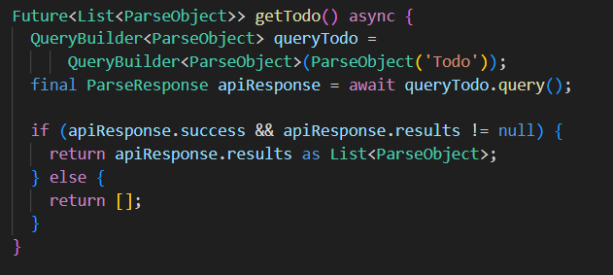
Important Code Snippet
Code for Read Object
The read function is responsible for querying the database and returning the list of objects
Create an instance of Parse’s Query class.
Do a Query search method using the query() method.
If the operations succeed, a list of Todo objects will be returned. If no object is found, the success property is false, and the results are null.

Slide 13
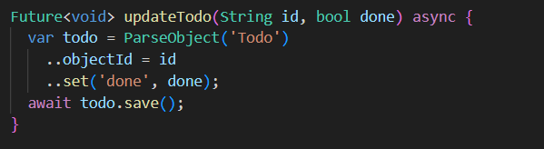
Important Code Snippet
Code for Update Object
The update function is responsible for updating a task as completed or not.
Make a new instance of the Parse Todo class with the command ParseObject('Todo’).
Use the objectId property to set objectId of ParseObject that must be updated.
Use the set function to modify the parameters done your Task.
Call the save function, which will push the changes on the task to your database in the Parse Dashboard.

Slide 14
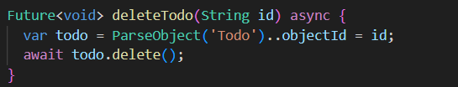
Important Code Snippet
Code for Delete Object
The delete function is responsible for removing a task from the database. It is an irreversible action, which means that you should be careful while using it.
Make a new instance of the Parse Todo class with the command ParseObject('Todo’).
Use the objectId property to set the objectId of ParseObject that must be removed.
Call the delete function, which will remove the task from the database in the Parse Dashboard.

Slide 15
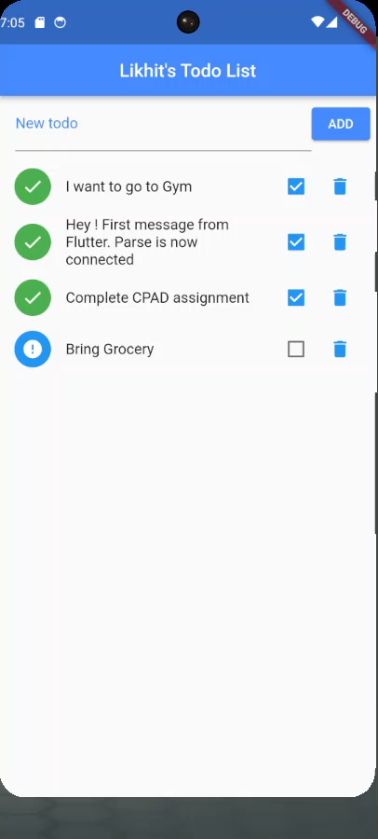
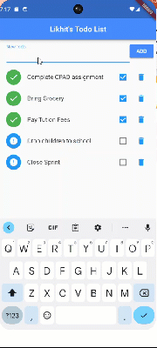
Demo

Slide 16

Source Code - Git Hub Link
https://github.com/likhitgatagat/flutter_todo_app

